Slide 1

RC CAR

Slide 2
Agenda
-transistor
-Dc motor
-connection of low load dc motor with arduino
-servo motor
-communication protocol

Slide 3
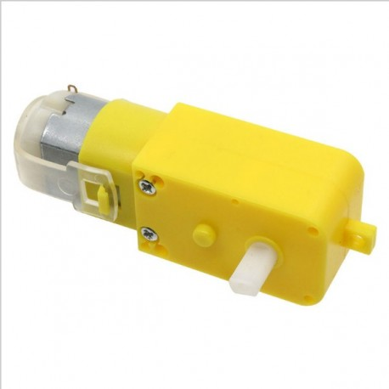
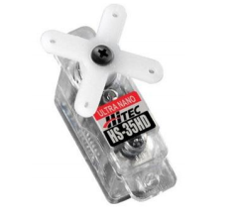
DC SERVO

Slide 4
Why dc motors?
-From main elements used in electronic projects.
- responsible for converting electrical energy to mechanical energy in the form of rotation

Slide 5
DC motor applications

Slide 7
Interface to micro-controllers(arduino)
1.direct connection(wrong) burns the arduino :(
2.connection with transisor
3-using l298 motor driver(hbridge)

Slide 8
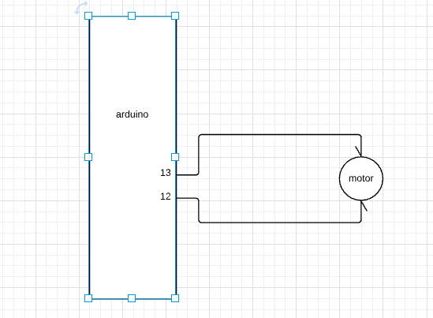
Wrong connection as arduino(atmega) from data_sheet sink current is 25 mA And motor needs more current so this burns arduino.

Slide 9
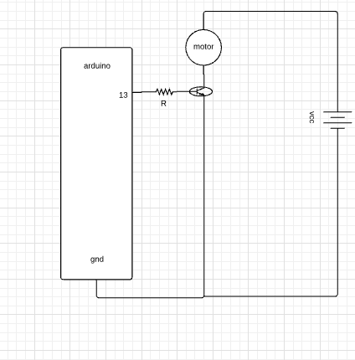
This will not burn arduino as current in R is small which is suitable to arduino also current In motor can be handled by transistor. This circuit enables us to control motor in one direction

Slide 10
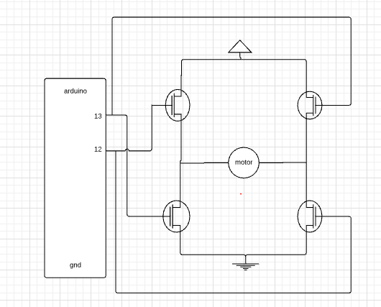
This enables control motor in two directions

Slide 11

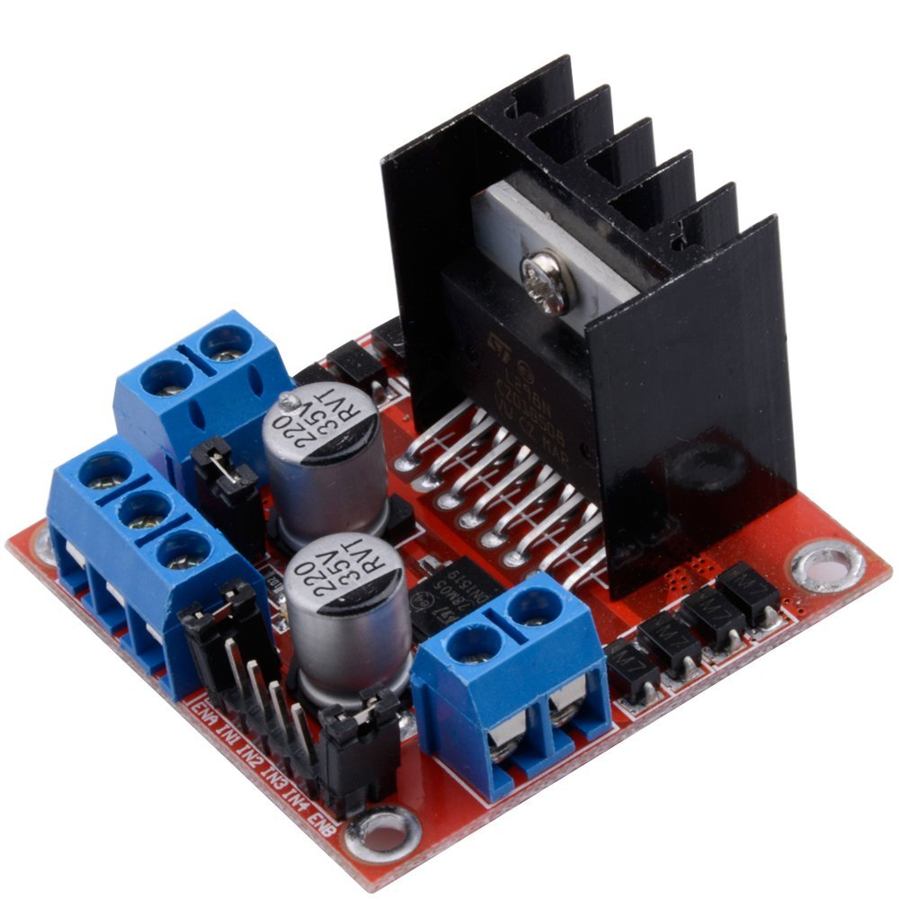
DC Motor drivers
Motor 2
L298N H-bridge
Motor voltage(up to 12 V)
GND
5V
Pwm for motor1
Motor1 enable
Pwm for motor 2
Motor 1
Motor2 enable

Slide 12
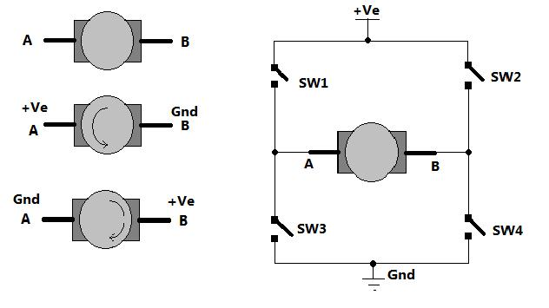
DC Motor control
Hbridge contains 2 circuits from that(i.e 8 transistors) so used to control 2 motors also Can be used to control 4 motors how?! -note transistor is an electronic switch(so we draw switch for simplicity).

Slide 13
Practice
time

Slide 14
control the speed of a simple DC motor.

Slide 15
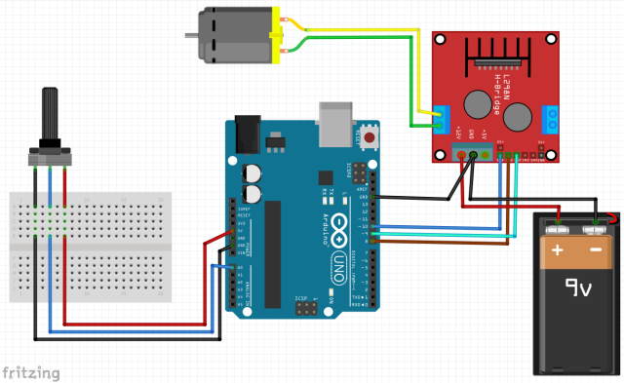

Slide 16
Servo Motor
https://youtu.be/ZZhuD78BLDk

Slide 17
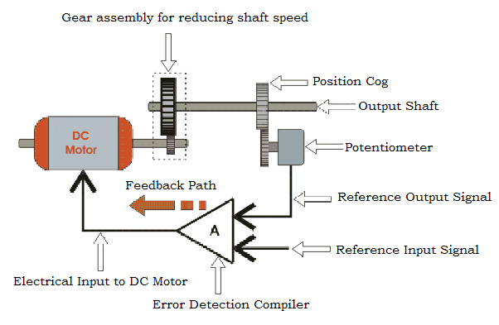
‹#›

Slide 18
Servo motors
Advantages:
1.Position control.
2.High Torque.
3.Variety.
Disadvantages:
1.No continuous motion, limited to 180 degrees

Slide 19
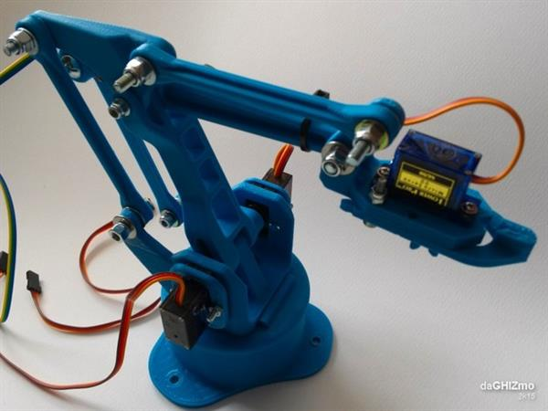
Application
‹#›

Slide 20
Servo Functions
#include <Servo.h> //library include
Servo myservo; //object creation
myservo.attach(pinNum); // at void setup
myservo.write(angle_value); // at void loop

Slide 21
Work
time

Slide 23
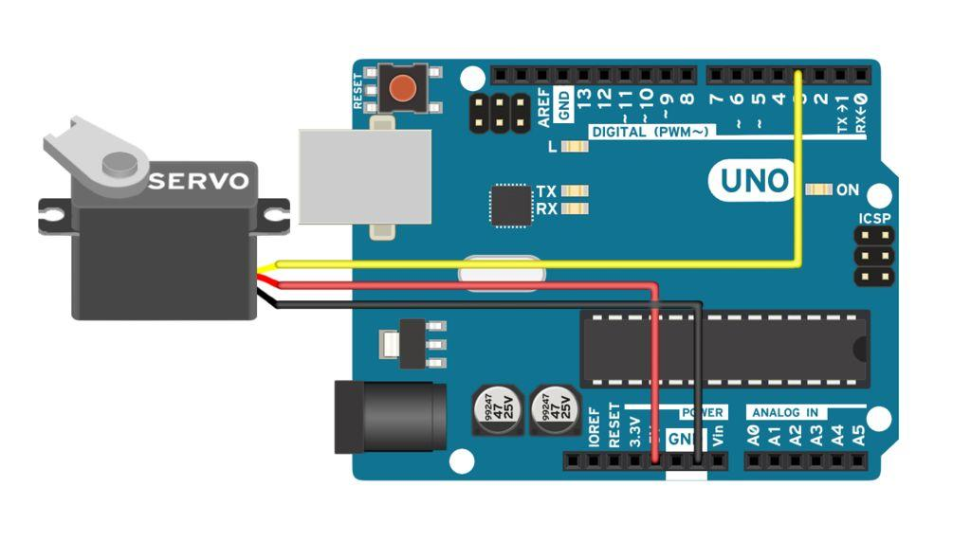

Slide 24
BREAK!

Slide 25
communication

Slide 26
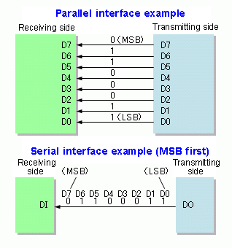
Notes:
Common serial protocols include UART, SPI, RS485 and I2C
Serial Data Transmission
§ bit by bit transmission.
§ less transfer lines.
§ long-distance communication
§ Slow comparatively, but less
expensive
Parallel Data Transmission
§ N bit at a time transmission.
§ More transfer lines.
§ Short -distance communication
§ Fast, but expensive
Used for printers, scanners and plotters

Slide 27
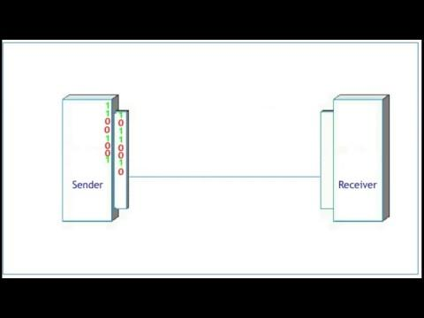
Notes:
https://www.youtube.com/watch?v=PJ_bS7meE7s

Slide 28
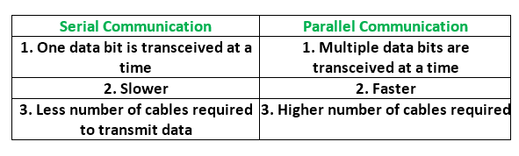
Vs

Slide 29
What is protocol!

Slide 30
Serial Communication Protocols
Ethernet
I2CInter-Integrated Circuit
RS-232
SPI (Serial Peripheral Interface)
UART (Universal Asynchronous Receiver/Transmitter)
USB (Universal Serial Bus)

Slide 31
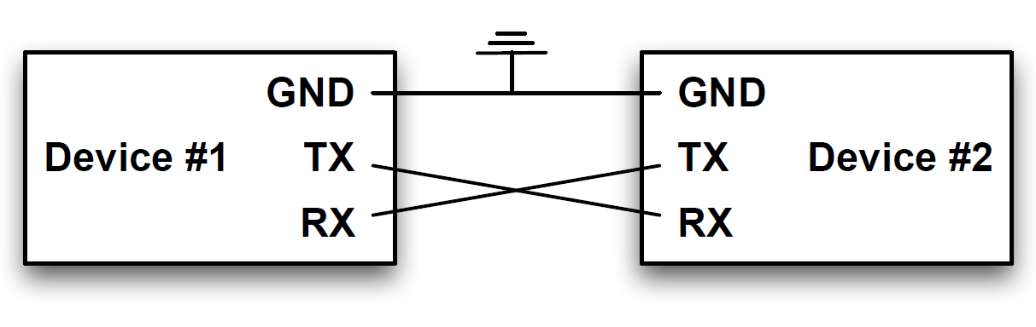
UART

Slide 32
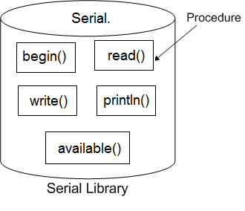
Arduino Serial

Slide 33
Serial.begin(9600);
//9600 is the baud rate
Serial.print(“hello”);
Serial.println(“hello tani”);

Slide 34
Baud rate
bits-per-second (bps).
1200, 2400, 4800, 9600, 19200, 38400, 57600, and 115200.

Slide 35
Work
time

Slide 36
Task
Controlling LED using computer serial monitor when send ‘1’ led_on ‘0’ led_off .

Slide 37
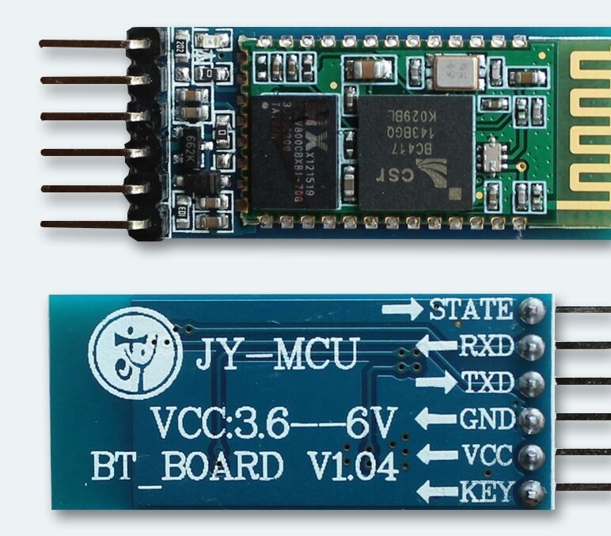
bluetooth module

Slide 38
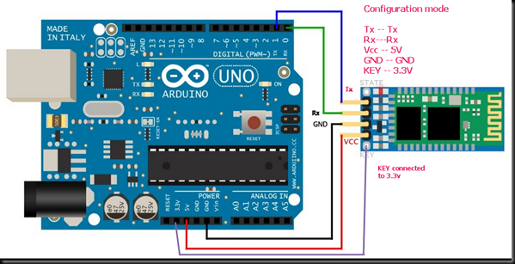

Slide 39
THANKS!
Any questions?
You can find me at
khaled.abdelgalil96@gmail.com

